Slide 1
Probability
EQ – How do I calculate probabilities of combined events using two-way tables?

Slide 2
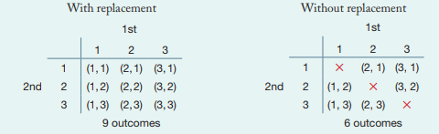
TEACHER SLIDE:
Teacher note: Give students post it notes and get them to label them 1, 2 and 3. Get students to do pick 2 cards ( but replacing the first card then picking up the second)
Get students to then pick 2 cards without replacement
Here are the two-way tables showing the outcomes when the card is replaced each time versus when there is no replacement
Get students to come up with and then copy these tables into their INB

Slide 3
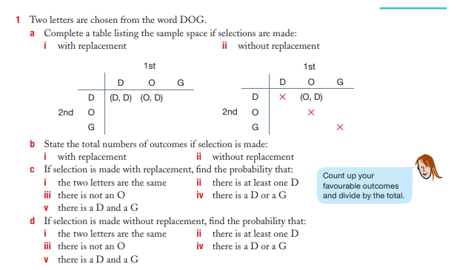
We do together: Complete this in your Interactive notebook
Using two-way tables to calculate probabilities in situations that involves replacement and no replacement

Slide 4
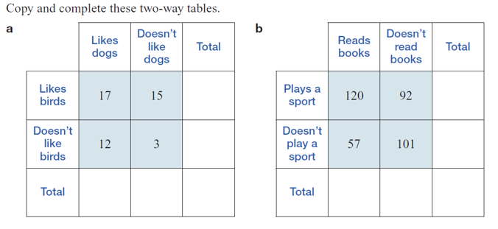
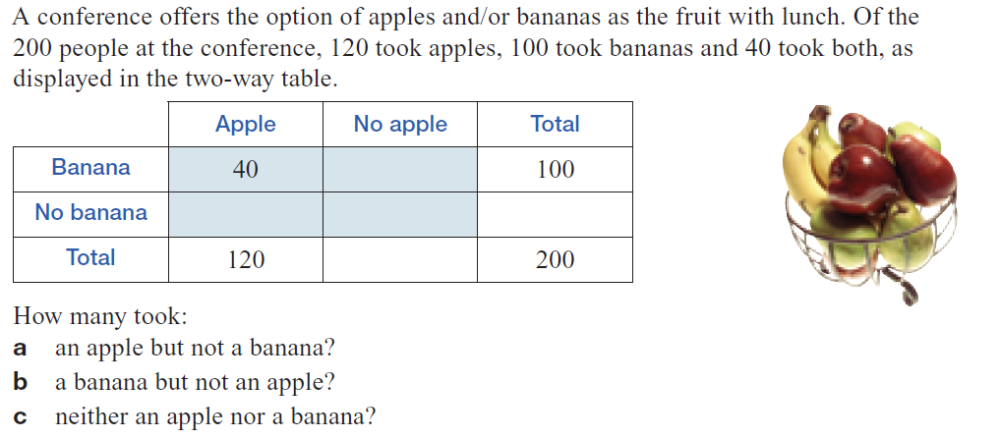
Your turn: Complete this in your Interactive notebook
Using two-way tables to calculate probabilities
3.
4.
Notes:
Guided practice

Slide 5
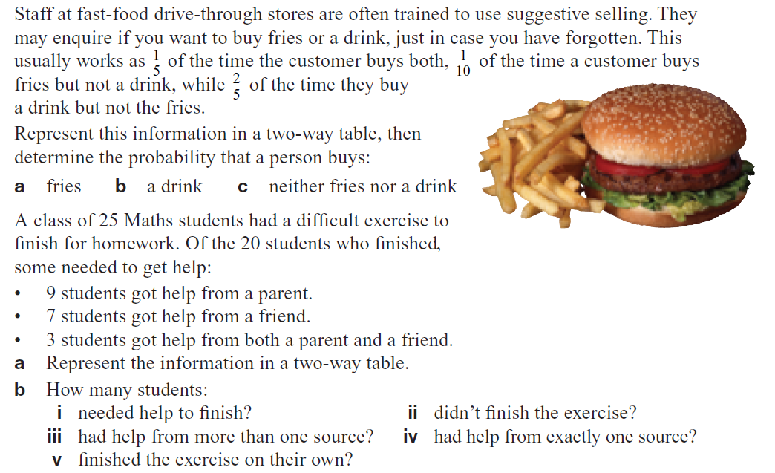
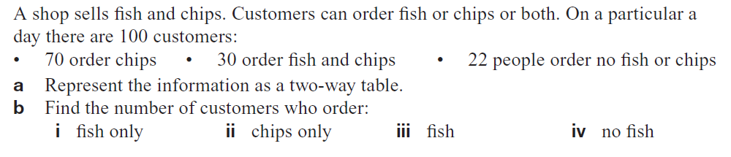
5.
6.
7.

